Slide 1



Customer Retention
View in Power BI
Last data refresh:
4/5/2022 9:24:45 PM UTC
Downloaded at:
4/6/2022 3:02:47 AM UTC

Slide 2
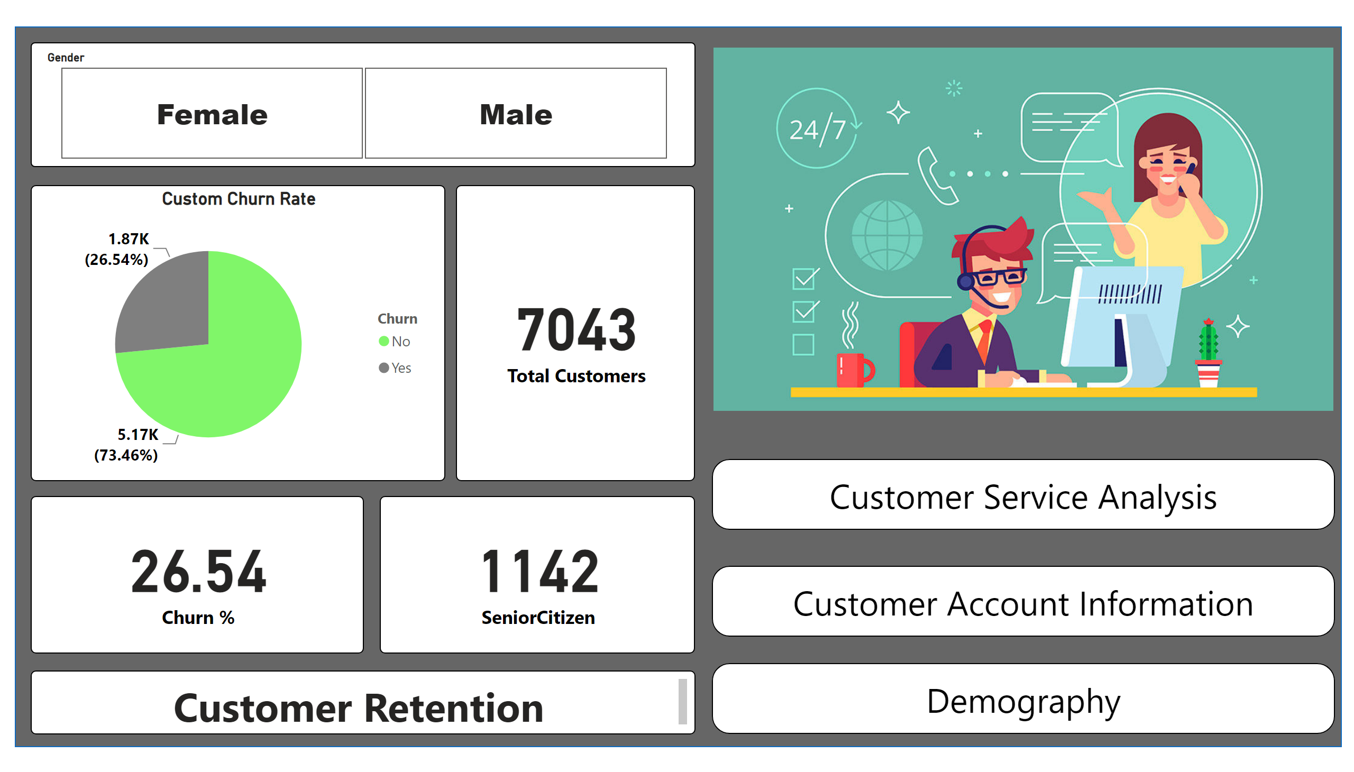
Home
Notes:
slicer
No alt text provided
image
No alt text provided
Custom Churn Rate
No alt text provided
card
No alt text provided
card
No alt text provided
card
No alt text provided
textbox
No alt text provided
shape
No alt text provided
shape
No alt text provided
shape
No alt text provided
shape
No alt text provided

Slide 3
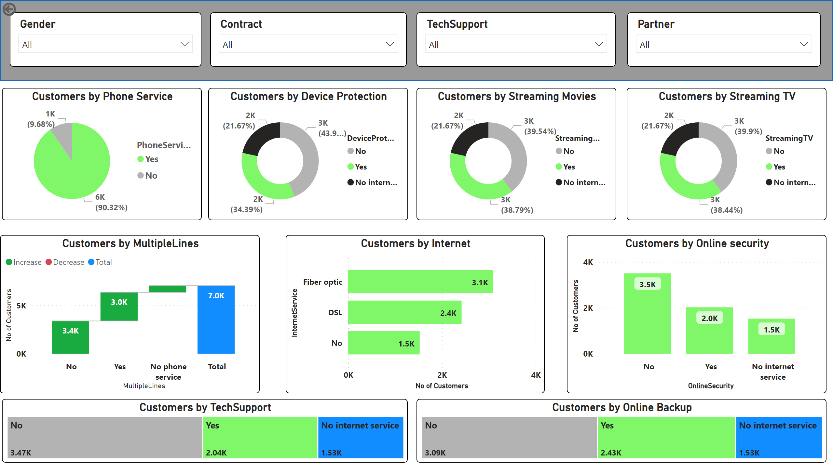
Customer Service Analysis
Notes:
slicer
No alt text provided
slicer
No alt text provided
slicer
No alt text provided
slicer
No alt text provided
shape
No alt text provided
Customers by Phone Service
No alt text provided
Customers by MultipleLines
No alt text provided
Customers by Internet
No alt text provided
Customers by Online security
No alt text provided
Customers by Device Protection
No alt text provided
Customers by Streaming Movies
No alt text provided
Customers by Streaming TV
No alt text provided
Customers by TechSupport
No alt text provided
Customers by Online Backup
No alt text provided
actionButton
No alt text provided

Slide 4
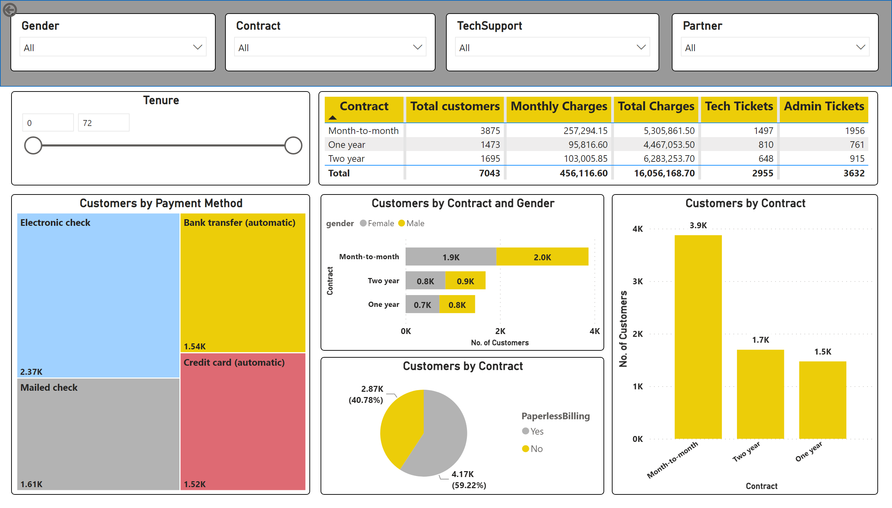
Customer Account Information
Notes:
slicer
No alt text provided
slicer
No alt text provided
slicer
No alt text provided
slicer
No alt text provided
shape
No alt text provided
Tenure
No alt text provided
tableEx
No alt text provided
Customers by Contract and Gender
No alt text provided
Customers by Contract
No alt text provided
Customers by Payment Method
No alt text provided
Customers by Contract
No alt text provided
slicer
No alt text provided
actionButton
No alt text provided

Slide 5
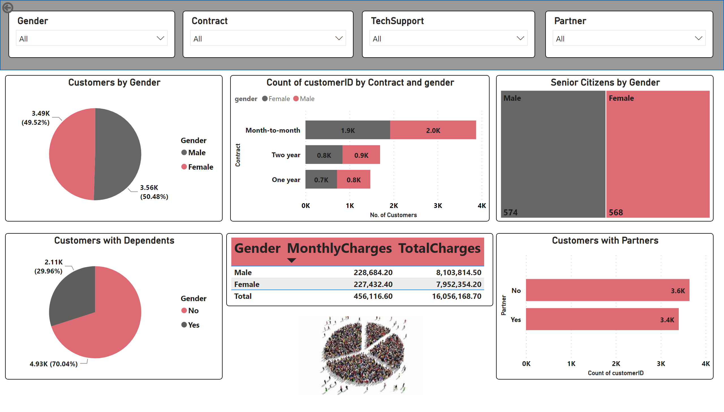
Demography
Notes:
slicer
No alt text provided
slicer
No alt text provided
slicer
No alt text provided
slicer
No alt text provided
shape
No alt text provided
Customers by Gender
No alt text provided
barChart
No alt text provided
Senior Citizens by Gender
No alt text provided
Customers with Dependents
No alt text provided
tableEx
No alt text provided
Customers with Partners
No alt text provided
image
No alt text provided
actionButton
No alt text provided

